Slide 1
Building a Simple Network
Securing the Network

Slide 2
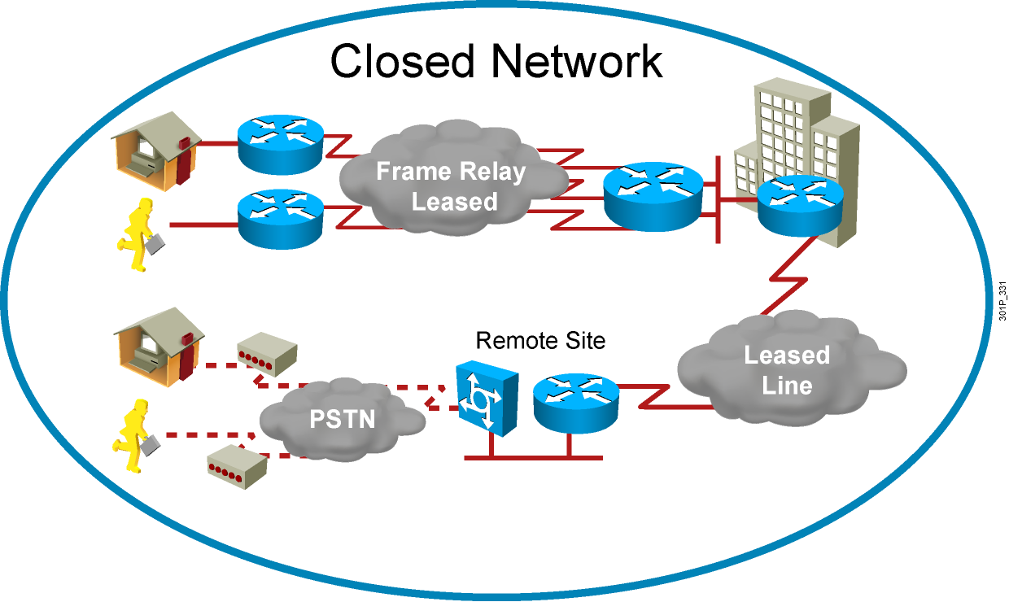
Closed Networks
Attacks from inside the network remain a threat.

Slide 3
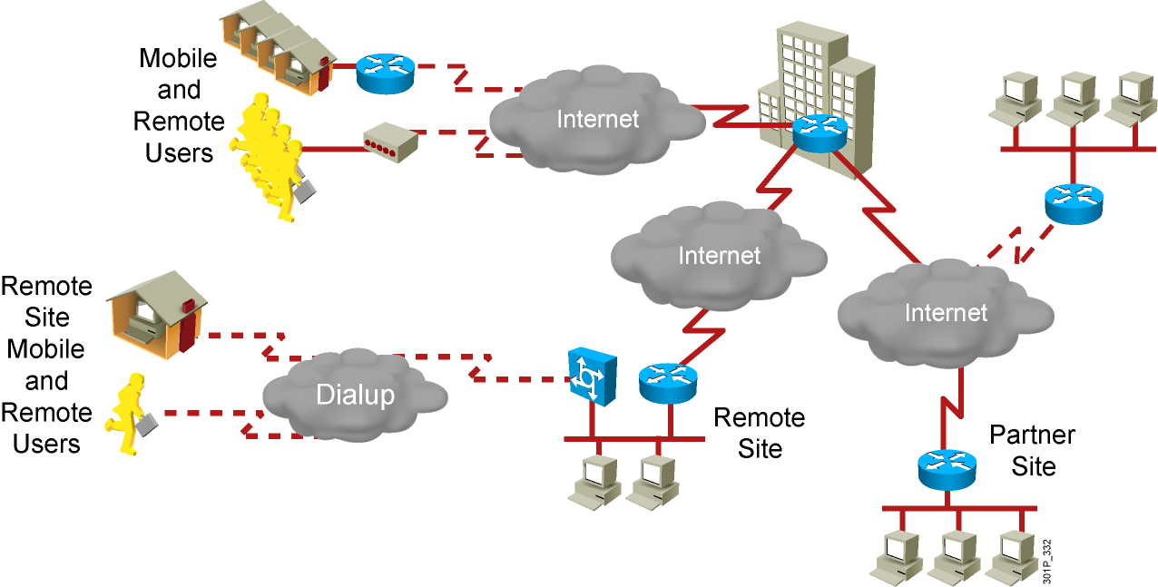
Open Networks

Slide 4
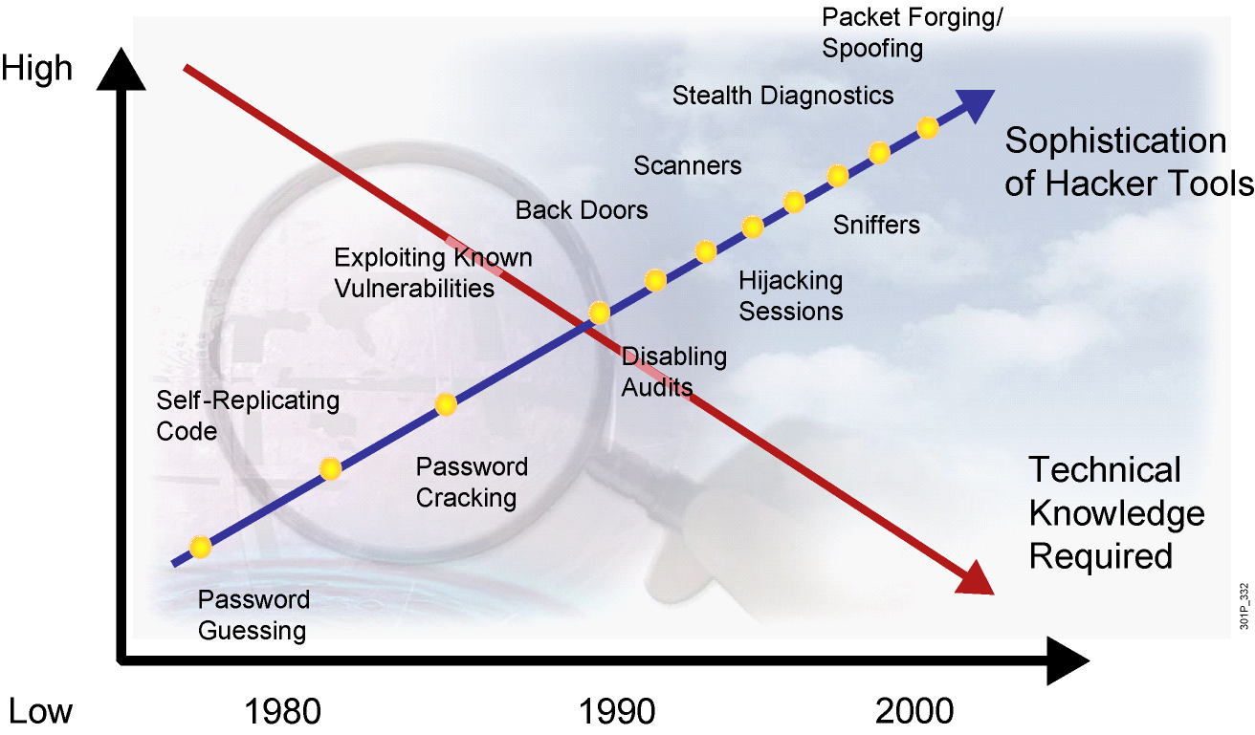
Threat Capabilities—
More Dangerous and Easier to Use

Slide 5
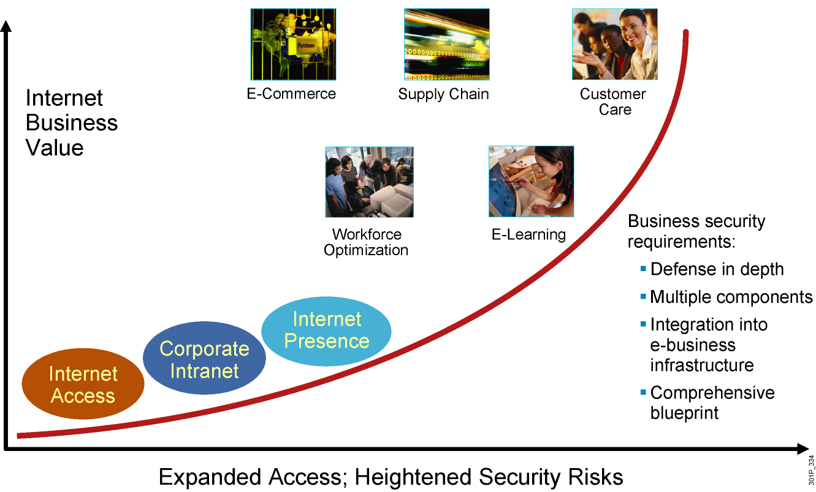
E-Business Challenge

Slide 6
Adversaries, Adversary Motivations, and Classes of Attack
Adversaries |  | Motivations |  | Classes of Attack
Nation-states Terrorists Criminals Hackers Crackers Competitors “Script kiddies” Disgruntled employees Government |  | Intelligence Theft DoS Embarrassment Challenge |  | Passive Active Close-in Insider Distributed

Slide 7
Common Threats
  Physical installations
    Hardware threats
    Environmental threats
    Electrical threats
    Maintenance threats
  Reconnaissance attacks—Learning information about a target network by using readily available information and applications
  Access attacks—Attacks on networks or systems for these reasons:
    Retrieve data
    Gain access
    Escalate their access privileges
  Password attacks—Tools used by hackers to compromise passwords

Slide 8
Password Attack Threat Mitigation
Here are password attack threat-mitigation techniques:
  Do not allow users to use the same password on multiple systems.
  Disable accounts after a certain number of unsuccessful login attempts.
  Do not use cleartext passwords.
  Use “strong” passwords; for example, “mY8!Rthd8y” rather than “mybirthday.”

Slide 9
Summary
  Sophisticated attack tools and open networks continue to generate an increased need for network security policies and infrastructure to protect organizations from internally and externally based attacks.
  Organizations must balance network security needs against
  e-business processes, legal issues, and government policies. Establishing a network security policy is the first step in changing a network over to a secure infrastructure.
  Network adversaries come in many shapes and sizes and with multiple motivations.

Slide 10
Summary (Cont.)
  It is very important to provide physical installation security for enterprise network devices.
  Password attack threats can be mitigated.
    Restrict password use.
    Disable accounts after unsuccessful logins.
    Do not use cleartext passwords; use strong passwords.

